Slide 1
COINS Transformation Project
CLINT SCHMIDT
Executive Director, Research Security and Conflict of Interest
Office for Research Protections

Slide 2
COINS Transformation
Institutional Conflict of Interest (AD83)
Individual Conflict of Interest (RP06)
Conflict of Commitment (AC80)
Notes:
Faculty disclosures are currently governed by 3 policies:
RP06: research related conflict of interest policy
AD83: institutional conflict of interest policy that applies to University Officials
AC80: conflict of commitment & outside professional activities policy (under Vice Provost for faculty affairs) that is currently a PDF based process
Benefits of COINS transformation project
Researchers
Will no longer have to enter information about their research projects into COINS
Transformed COINS will integrate with University systems such as CATS IRB and SIMS to pull awards and protocols
Will streamline the disclosure process by bringing the AC80 process into COINS along with the other disclosures required of faculty
Faculty will complete one online form that covers all 3 disclosure policies
COI staff will review the disclosures according to how they are impacted by the policies
Bringing the AC80 process into COINS will help with compliance with federal regulations, especially the new requirements related to research security.
There were some changes to AC80 in the recent years requiring prior approval for certain activities that could be indicators of potential foreign talent recruitment programs
Having these former PDF based disclosures in one electronic system will be a great improvement

Slide 3
Partnership
Penn State
Huron Consulting Group
Sponsors
Office of the Vice Provost for Faculty Affairs
Office for Research Protections
COINS Transformation
Project
Support
Office of the Provost
Senior Vice President for Research
Penn State Conflict of Interest Program
College of Medicine Conflict of Interest Office
Office of Research Information Systems
Advisory Committee (Future State)

Slide 4
Impacts to User Groups
Teaching Faculty: AC80 awareness prior to launch
Researchers Submitting Proposals:
Fall 2024
Department Heads:
Fall 2024
All Users in COINS:
Spring 2025
Notes:
Researchers submitting proposals in Fall 2024
New system will go live in September 2024
Existing COINS information will not transfer over
For those with a research proposal going in Fall of 2024, they will have to re-submit their disclosure in the new system
We will continue to provide communication around this, but please reinforce this messaging
Department Heads
Will no longer be required to review disclosures
But will be required to review and approve/deny Prior Approval Forms in COINS
Requests will first be sent to COI office, who will review for compliance
Then DHs are reviewing against the faculty member's workload / time commitment / performance, etc.
All Users – will be in Transformed COINS in Spring 2025
We will have various training opportunities available, from help text in the system to just-in-time resources and live webinars where people can ask questions.
However, no training is required to use the system

Slide 5
Data Feed to IAF
Improved Layout
Additional types of Disclosure Information
Support Available for AORs: Go live Fall 2024

Slide 6
Resources for Disclosure Requirements
Live webinars, videos, and job aides: Visit www.research.psu.edu/coi/training
In-person training: Request via email cls65@psu.edu
Notes:
If you think that your faculty need a refresher on their disclosure responsibilities, we have several resources such as live webinars, and self paced resources such as videos and job aides.
We are also available to provide training in person, just send us an email.
We will come to your faculty department meeting and do a 10 minute overview of what activities require disclosure and prior approval.

Slide 7
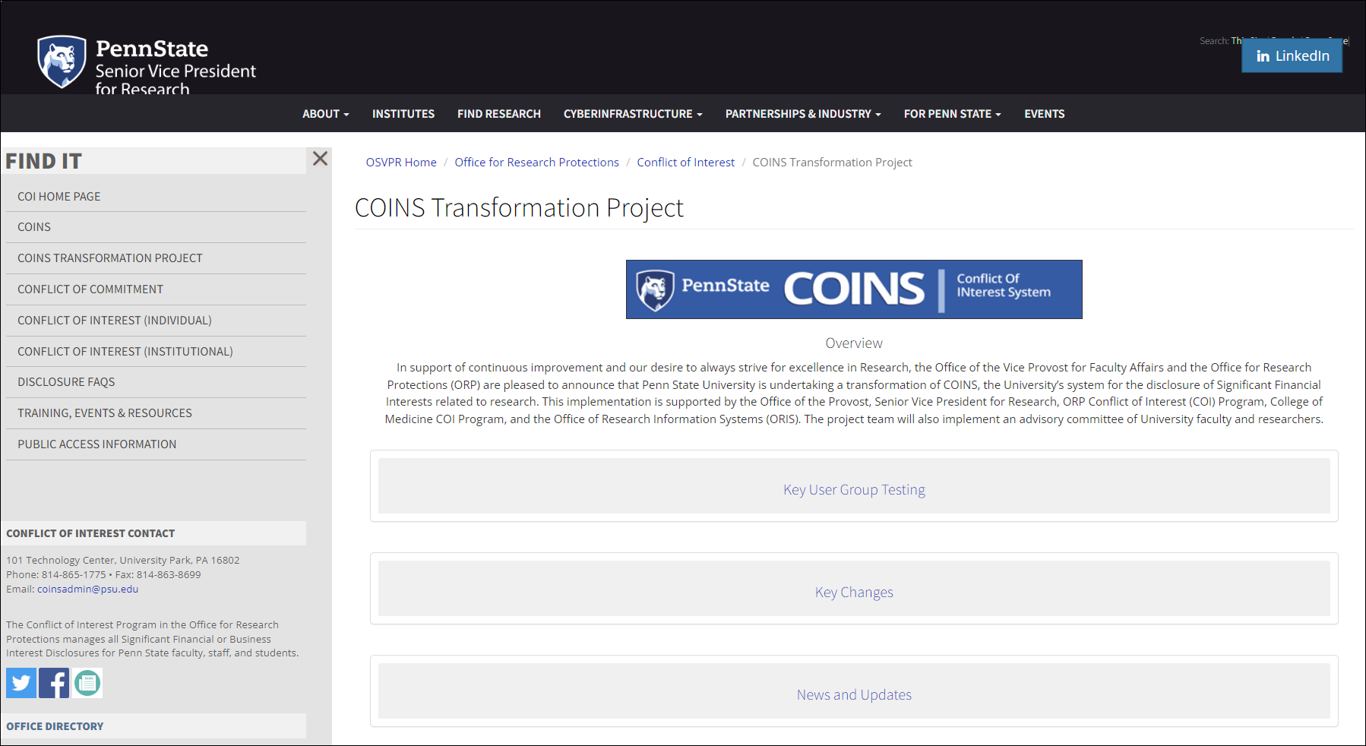
COINS Transformation Project Website
Send us your general comments and questions via the online form in the “Contact Us” section of the website.
Researchers may sign up for Key User Group testing, email Morgan Rhinehart at mar472@psu.edu.
www.research.psu.edu/coi/COINS-Transformation-Project
Notes:
We do have a project website
Can stay up to date on the project, including the most recent timeline, project updates, and available resources,
The project team wants to hear from you and find out how we can assist.
Please send us your thoughts, questions, and comments via the online form in the “Contact Us” section of the website
Direct link to feedback form, if needed https://forms.office.com/r/DwUi2zJqf6

Slide 8
HRPP Updates:
2023 University-wide Satisfaction Survey
2024 AAHRPP Re-accreditation
78% of respondents indicated they are satisfied or very satisfied
Overall improvement in satisfaction from all research roles since the 2022 survey
HRPP Satisfaction Survey Results | Research at Penn State (psu.edu)
Step 1 application will be submitted this week
Folks in this group may be contacted for the site visit – late Summer/early Fall

Slide 9
THANK YOU! Questions?
CLINT SCHMIDT, cls65@psu.edu
Notes:
Thank you for your time and attention today

