Slide 1
Introduction to Pure
Amanda Snyder
Associate Director, Research Analytics & Communications
Office of the Vice President for Research
ajs52@psu.edu

Slide 2
Today’s agenda
What is Pure
Tour of online portal
Why Pure? (Another product!?)
About
Frequently Asked Questions / What about Google Scholar
How to get help
How to edit your information
Questions from the audience

Slide 3
What is Pure
Open Research Information Management System (Elsevier)
Aggregates research information from internal and external sources into one single platform, and creates relations among the different content.
Scholarly output – automatically updated
Facilities / Equipment
Projects
Data sets
Grants
Patents / IP
Public and Administrative Portals
Public – searching, fingerprint, research network
Administration– editing, reporting

Slide 4
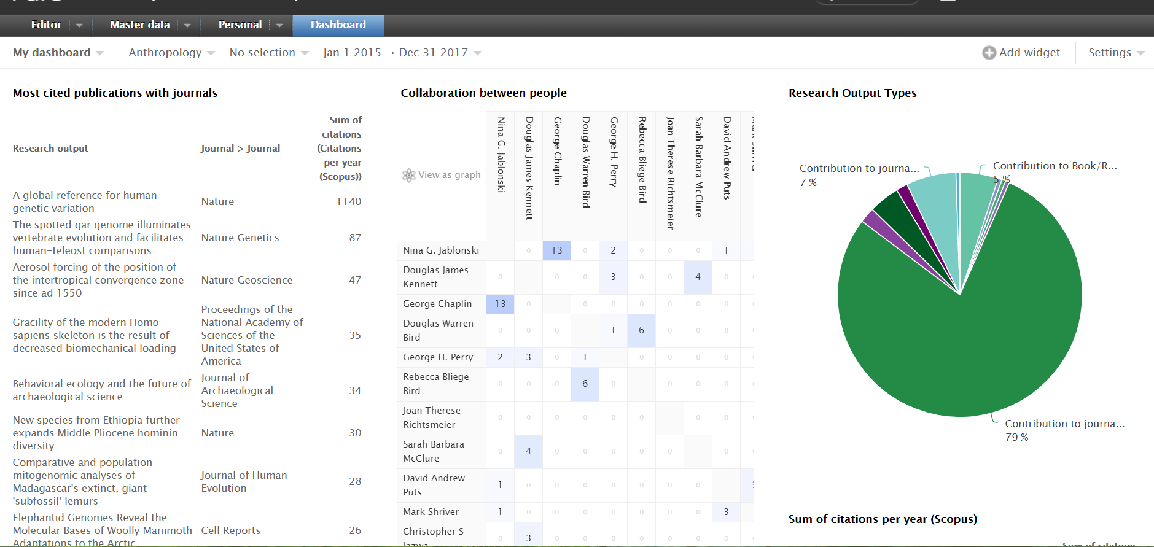

Slide 5
How to view Pure
pennstate.pure.elsevier.com
(Or visit Research.psu.edu/about and click on Penn State Research Database)
Presently, only Penn State IP addresses can access the public-facing search interface. If you are physically off-campus, use the LIAS VPN to access the home page of the research database.
Let’s begin the online tour now!

Slide 6
Why Pure?
Showcase Research at Penn State
Enhances visibility of research at Penn State both internally and externally
Expertise Discovery
Industry Partnerships
Collaborations
Reporting
Strategic Planning
Performance Dashboards
Repurposing Data
Webpages
Activity Insight
CVs
Centralized information repository
Shared facilities
(Pure will not replace Activity Insight)
Notes:
Image:
MRI collaboration with External research units in 2017 to 2018 with more than 10 publications

Slide 7
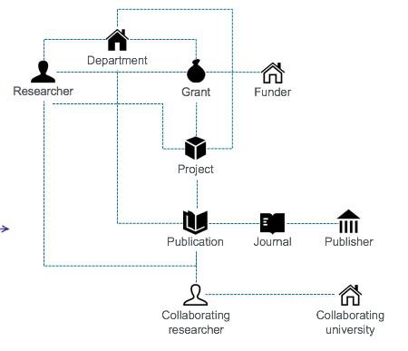
The information in Pure is
Structured
Uniquely identified
Inter-related
Homogeneous
Pure is NOT:
Faculty reporting
A directory of faculty
Everything

Slide 8
Pure Research Portal Implementation
Acquisition
of Pure
Portal
Pre-launch
Portal
Soft Launch
Onboarding
Phase I
Improvements
Public Launch
Phase II
Improvements
--Business case & demos start: Spring 2015.
--Vendor chosen; Penn State purchasing process completed.
--Delivery from Elsevier: Fall 2016.
Mar. 30, 2017
--Penn State campuses can view the beta portal.
--Minimum Viable Launch (MVL) determined.
--Campus & Dept. tree built/faculty placed into primary home. 90% done
--Sample profiles entered (1-3 each of faculty, microscope example, institutes).
--Baseline “Named Titles” entered.
--Web dev for MVL support portal begins.
--Approval by Pure Advisory Committee: April 21, 2017
Sept.18-22, 2017
--Faculty training materials created & marketed to faculty.
--Online support system built out with faculty “How to” docs.
--Initial user tests.
--COM using API.
--Data and hierarchy refinements.
--Initial roadshows.
--OVPR & COM staff trained on reporting, systems, etc.
--Official Penn State launch and roadshow:
Dec. 4 - 8th, 2017
--Further refinement and improvement of data.
--Researchers’ opportunity to make corrections to their profiles prior to public launch.
Adding modules:
--Enter examples of Projects/Facilities/ Datasets
--Activity Insight Data Integration continuing.
January, 2018 (turn off IP restriction)
--External user testing.
--Marketing materials. --”How to” documentation and support for all users.
Adding modules and data:
--Grants
--Datasets
--Increase API support for data pulls.
--Support documentation for Admin Portal and reporting.
--Open profile creation for postdocs
--Add new hires
Facilities Module
-Shared user facilities collected and reflected in Pure.
Training
Training faculty & their proxies.
Events & Outreach
Training research administrators on reporting & Admin Portal.
Train the Trainers:
-Subject-matter librarians.
Maintenance
Development of maintenance protocols, PRS updates.

Slide 9
250+ Pure Implementations world-wide
58 within the USA
Big Ten
University of Michigan (4880)
University of Minnesota (6761)
University of Nebraska (1445)
University of Illinois (2081+2727)
University of Maryland
Michigan State University (2963)
Northwestern University (4419)
Indiana University (842)
Others
Arizona University System
iResearchGeorgia
Michigan Corporate Relations Network
The University of Texas System
Johns Hopkins University
New York University
UC Davis
Notes:
>230 clients in 33 countries today (More clients than the next five competitors combined)
Pure is currently used to manage profiles of over 640,000 researchers; these profiles are viewed more than 4,400,000 times per month.

Slide 10
FAQ
Who has profiles in Pure?
Where does the information come from? Who updates it?
What about Google Scholar?
Citations
Importing your Google Scholar Profile (no, you can’t.)
How to get help
How do I get myself/a project/center/equipment in Pure?
Who is in charge here?!
Can I change my information?

Slide 11
Who is in Pure at Penn State?
Up to 5499 profiles (We pay by the number of profiles)
All Campuses (Initial data from HR)
ACTIVE RESEARCHERS
Typically, tenure track
Research associates, research assistants, scientists
Exclusion Criteria
No instructors or lecturers (This does not apply to CoM or Law)
Upon request, people who are active in research
Published within the past 5 years
Demonstrable research program
Post-docs and Graduate students
Researchers in Pure but not active in research may be removed

Slide 12
Where does the “starter” information come from?
The Profile Refinement Service (PRS)
Before importing Scopus data into Pure, the Profile Refinement Team subjects researchers' publication lists to automatic name disambiguation and rigorous manual review.
New publications are automatically added to each profile as they become available in Scopus.
We have this process scheduled 2x a year.

Slide 13
Scopus
69M records from 22K journals, 100K conferences and 150K books
from more than 5K publishers and 105 countries,
indexed into 27 main subject areas
Updated daily
Records back to 1786
“Articles in Press” from > 8,075 titles
40 different languages covered
3,643 active Gold Open Access journals indexed
Cited references on Scopus go back to 1970. As of August 2017, Scopus has added over 195 million pre-1996 cited references to nearly 11.5 million articles.
Scopus is an abstract and citation database
JOURNALS
CONFERENCES
BOOKS
PATENTS*
Physical
Sciences
7,441
562 book series
150K stand-alone books
1.2M items
Focus on Social Sciences and A&H
No, it’s not just
Elsevier journals!
21,951 peer-reviewed journals
280 trade journals
Full metadata, abstracts and cited references (refs post-1970 only)
Funding data from acknowledgements
Citations back to 1970
100K conference events
8M conference papers
Mainly Engineering and Computer Sciences
39M patents
From 5 major
patent offices
- WIPO
- EPO
- USPTO
- JPO
- UK IPO
Health
Sciences
7,133
Social
Sciences
8,698
Life
Sciences
4,601
As of August 2017
research.psu.edu

Slide 14
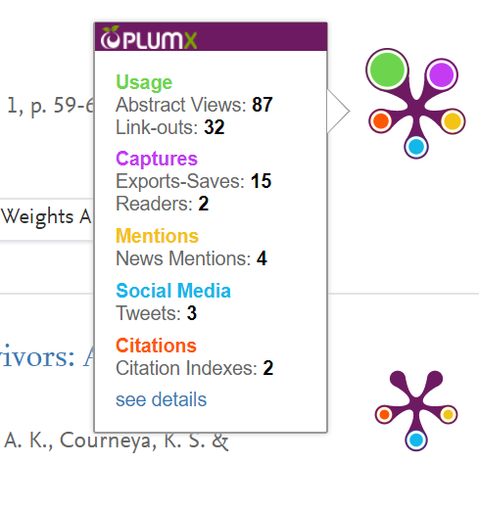
Initial Research Output comes from Scopus and Plum Analytics
Other possible import sources:
Mendeley
JournalTOC
Web of Science
arXiv
CAB Abstracts
PubMed
Worldcat®
SAO/NASA Astrophysics Data System
Embase
CrossRef
Espacenet
Scielo
CiNii
EbscoHost
GVK
Upcoming:
SSRN

Slide 15
Future integration with Activity Insight
From Pure to Activity Insight
Publication data can be easily extracted to BibTeX and imported into Activity Insight.
These two programs will grow and work together. We plan on using the API to automate this process for faculty.
Will help with Scopus weak areas like humanities, books

Slide 16
Who manages the information in Pure
Elsevier manages:
New publications (automatically added from Scopus)
Metrics
Profile Refinement Service (PRS) 3 times a year
Organizational Affiliations
Publication affiliations with authors and organizational units

Slide 17
Who manages the information in Pure
Penn State manages adding researchers (and administrators) and research units by coordinating with HR, Colleges, Schools, Institutes, Centers, Divisions and Departments.
The Penn State person/profile data must include:
Access ID
Name
Organizational Affiliation
Visibility (of group or person)
Titles/Associations (e. g. Division of Business and Engineering, Professor of Accounting)
Grants, Projects

Slide 18
Who manages the information in Pure
The researcher (or proxy) can* manage: (*excluding COM)
Name - Default Publishing Name, Former Name
Titles - Additional Standalone Titles
ORCID, Scopus ID, Mendeley Profile ID
Profile Photo
Links to Researcher Pages
Research Interests / Profile text
Positions outside of Penn State
Activities, Prizes
Education /Academic/Professional Qualifications
Fingerprints - Manually adjust certain keywords/concepts to lower association
Additional Research Output
Curricula Vitae (Multiple Additions possible)

Slide 19
What about Google Scholar…
H-Index & Citations
Can I import publications/output from Google Scholar… nope

Slide 20
Google Scholar
Advantages:
Google Scholar coverage/content and citations counts that are broader than those covered by Scopus or Web of Science
Disadvantages:
Not everyone has one
Searchability is limited
Bulk data downloads are not permitted
No grouping possible
No reuse of information
Quality control and indexing are lacking
e. g. no tagging
Any academic domain document is indexed and can emit and receive citations
Sources: HALEVI, Gali (2017). "Suitability of Google Scholar as a source of scientific information and as a source of data for scientific evaluation—Review of the Literature". Journal of informetrics (1751-1577), 11 (3), p. 823. Delgado Lopez-Cozar, Emilio; Robinson-Garcia, Nicolas; Torres Salinas, Daniel (2012). Manipulating Google Scholar Citations and Google Scholar Metrics: simple, easy and tempting. EC3 Working Papers 6: 29 May, 2012

Slide 21
Examples of Google Scholar Citations not found in Scopus or Web of Science:
Dissertations
Masters' theses
Bachelor's theses
Government reports
Course syllabi
Unpublished manuscripts
Reviews
Presentation slides
Blogs
Websites
Source: E.M. Lasda Bergman. Finding citations to social work literature: the relative benefits of using web of science, Scopus, or Google scholar. J. Acad. Librariansh., 38 (6) (2012), pp. 370-379, 10.1016/j.acalib.2012.08.002

Slide 22
Scopus, Google Scholar and Web of Science Comparison
Source: E.M. Lasda Bergman. Finding citations to social work literature: the relative benefits of using web of science, Scopus, or Google scholar. J. Acad. Librariansh., 38 (6) (2012), pp. 370-379, 10.1016/j.acalib.2012.08.002

Slide 23
Google Scholar
“Unlike the Web of Science and Scopus, Google Scholar doesn’t have a strong quality control process and simply crawls any information that is available on academic related websites. Although most of Google Scholar’s results come from publisher websites, its coverage does include low quality ‘‘publications’’ such as blogs or magazine articles.” (Harzing, AW. & Alakangas, S. Scientometrics (2016) 106: 787. https://doi.org/10.1007/s11192-015-1798-9)
Searching, aggregating, and downloading information in bulk in Google Scholar is currently not possible

Slide 24
Coverage request Minimum Criteria – Scopus Content
The Journal should consist of peer-reviewed content
The Journal should be published on a regular basis (have an ISSN number registered with the International ISSN Center)
The content should be relevant and readable for an international audience (at a minimum have references in Roman script and English language abstracts and article titles)
The Journal should have a publication ethics and publication malpractice statement

Slide 25
Scopus and Google Scholar Comparison
Source: E.M. Lasda Bergman. Finding citations to social work literature: the relative benefits of using web of science, Scopus, or Google scholar. J. Acad. Librariansh., 38 (6) (2012), pp. 370-379, 10.1016/j.acalib.2012.08.002

Slide 26
Something missing or inaccurate?
Correct the issue at the source - Scopus:
https://www.scopus.com/feedback/author/home.uri#/
Correction may take weeks to arrive in Pure

Slide 27
How to make a Title Suggestion for Scopus
http://suggestor.step.scopus.com/suggestTitle/step1.cfm
Suggestions are reviewed by the Scopus Content Selection and Advisory Board (CSAB)
Review process may take up to a year
titlesuggestion@scopus.com

Slide 28
Where to find help & tutorials:
First Stop: pennstate.pure.elsevier.com – Help
Help forms for specific questions, to request training, etc.
Also email: PSUPureSupport@psu.edu

Slide 29
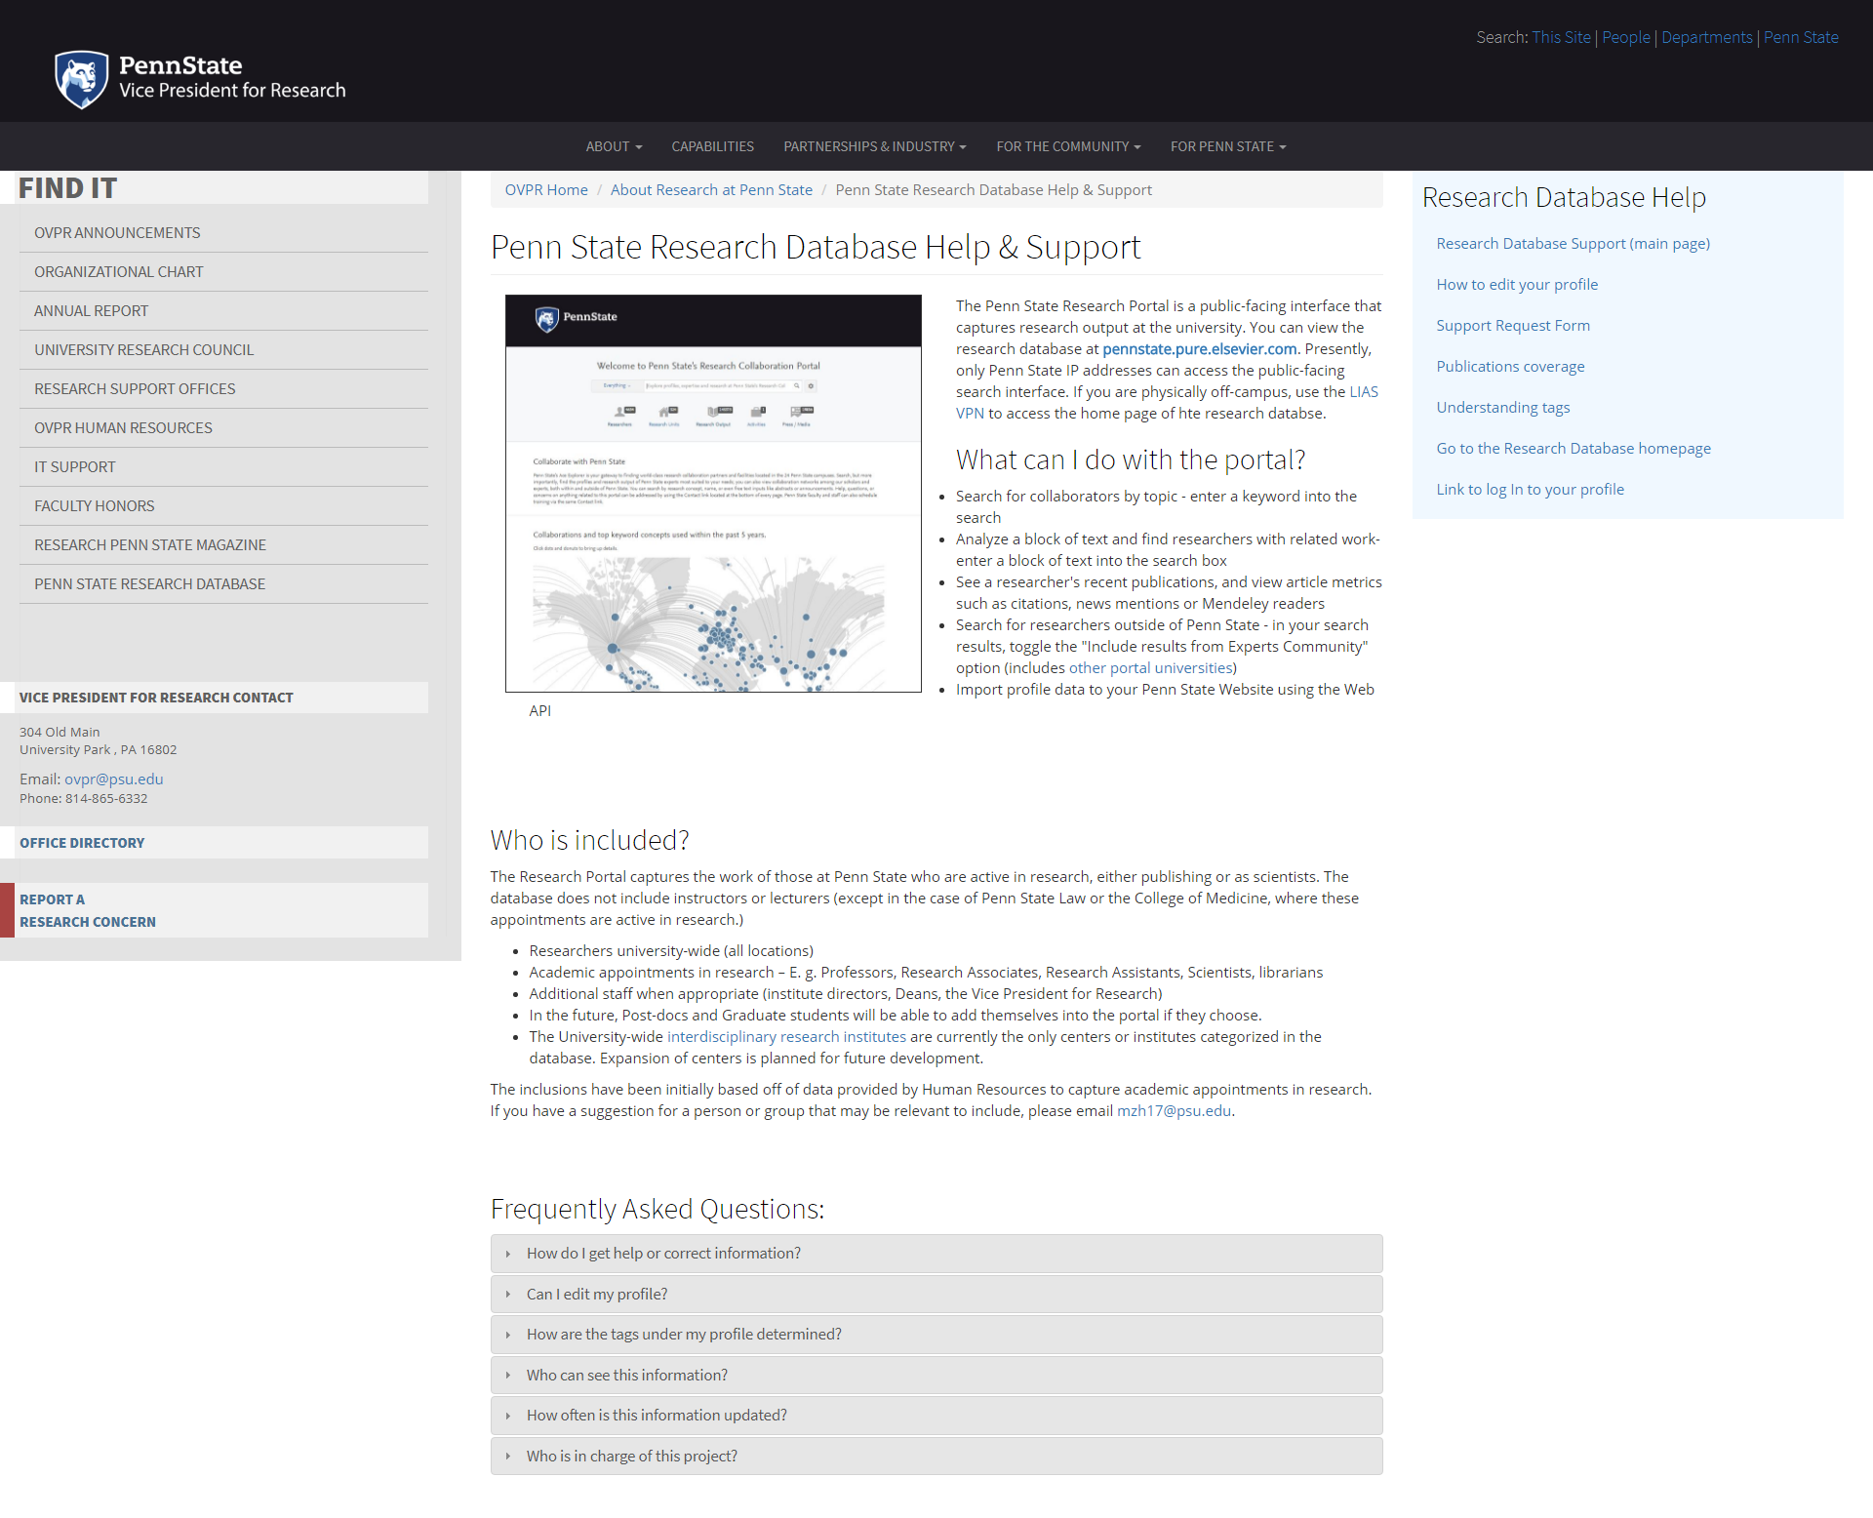

Slide 30
How do I get myself/a project/center/equipment added to Pure?

Slide 31
Penn State’s Pure Implementation Team
Michelle Hutnik (OVPR)
Amanda Snyder (OVPR)
Jeff Van Horn (OVPR/ORIS)
Jill Selfe (OVPR)
Dan Coughlin (Libraries)
Nicole Gampe (Libraries, Activity Insight)
Sarah Bronson (COM)
Robyn Reed (Libraries / COM)
Joan Concilio (COM)
Coordinated efforts by
OVPR, Libraries, COM

Slide 32
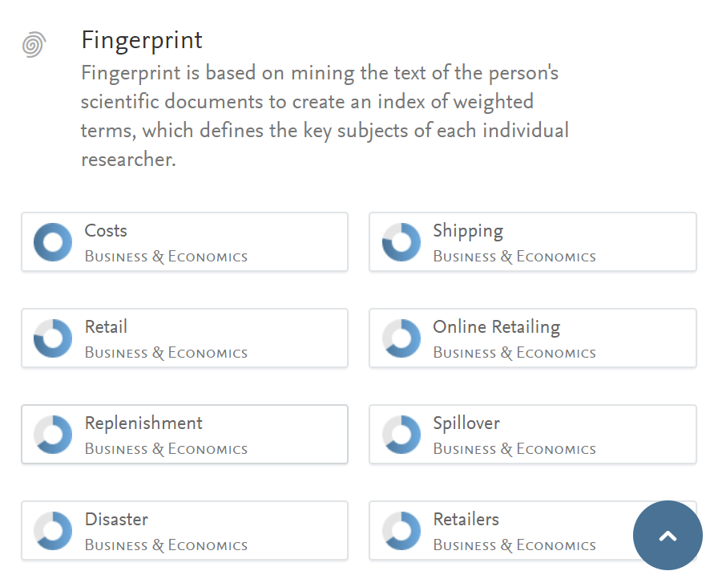
Can I change/add to my profile?
Yes!
Let’s edit a profile!
Is editing my profile mandatory?
No!

Slide 34
Questions?
Please type them into the Zoom interface.

Slide 35
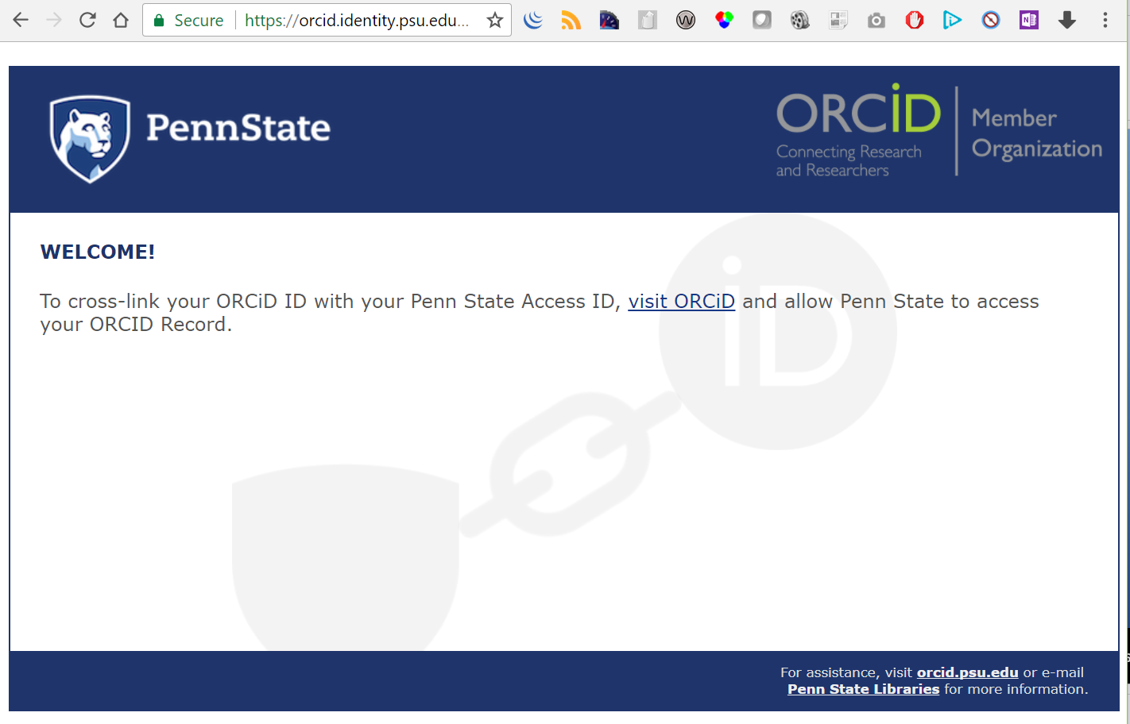
Tip Jar
Visit
Orcid.psu.edu
And Link your ORCID to your PSU Access ID.
THANK YOU!

